Slide 1

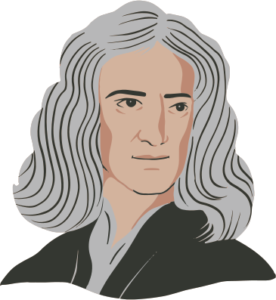
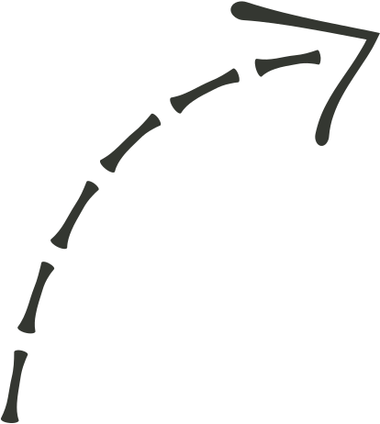
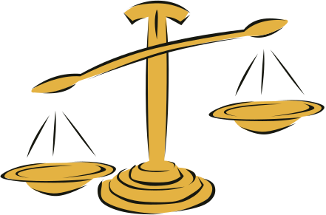

Newton's Laws of Motion
Force And Motion At Work

Slide 2


TODAY, WE'LL LEARN ABOUT...
How is force and motion related?
What did Isaac Newton observe?
What are Newton’s Three Laws of Motion
1.
2.
3.

Slide 3
RELATIONSHIP BETWEEN FORCE AND MOTION
A push, pull, or twist upon an object
An object free to move will move once acted upon by force.
It is often a result of an interaction between two objects.

Slide 4

MOTION
An object free to move will move once acted upon by force.
INERTIA
VELOCITY
An object’s resistance to changing its motion
The speed and direction of an object in motion
ACCELERATION
The change in an object's velocity

Slide 5
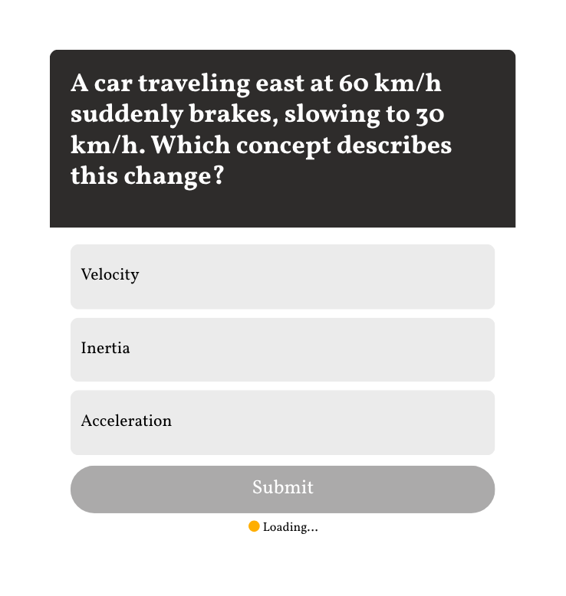
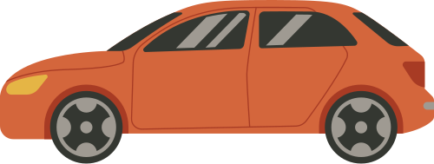

Think fast!
Teacher Tip: Double-click to customize this poll or quiz, or go to the Elements Tab for more options!

Slide 6

ISAAC NEWTON'S IDEAS
Apart from gravity, Newton also explained how the balance of forces affect an object's movement.
When forces are balanced, the object will remain in its state of motion (either at rest or in constant motion).
But when the forces are unbalanced, the object will either speed up, slow down, or change its direction.

Slide 7

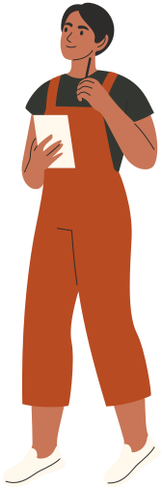

But what about other factors, such as friction and air resistance?
He further developed his ideas into what we know now as LAWS OF MOTION.

Slide 8

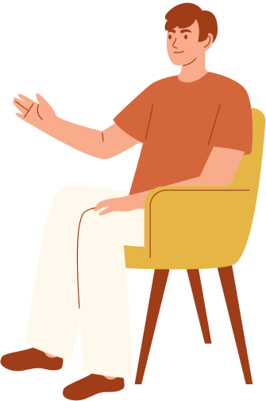
EXPERIMENT BREAK
Together with a seatmate, find different ways of moving your chairs in different directions without standing up.
What do you observe when you push each other at the same time?
What happens when the chair is pushed by the other person?

Slide 9
NEWTON'S FIRST LAW OF MOTION
1.
The Law of Inertia
Objects in motion will stay in motion, and objects at rest will stay at rest—unless acted upon by an unbalanced force.

Slide 10
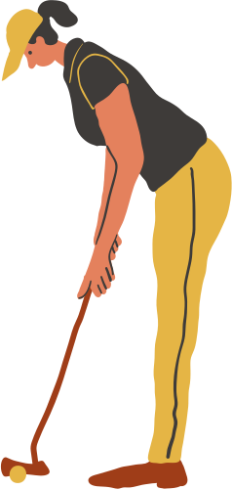
1.
The Law of Inertia
The golf ball will remain on the ground until the golfer hits it.

Slide 11
NEWTON'S SECOND LAW OF MOTION
2.
The Law of Acceleration
states that the acceleration of an object with constant mass is proportional to the net force action on it and is in the same direction of the net force

Slide 12
2.
The Law of Acceleration
The car accelerates forward since the force due to its engine is greater than the friction on the road.

Slide 13
NEWTON'S THIRD LAW OF MOTION
3.
The Law of Action and Reaction
Every action force has a reaction force that is equal in size and opposite in direction.

Slide 14

3.
The Law of Action and Reaction
On a rocket launch, the shuttle exerts a downward force, and the reaction force of the same size pushes it upward.

Slide 15
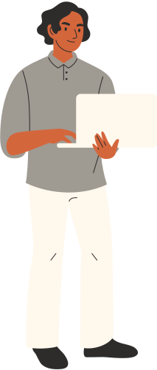
IT'S A WRAP!
The motion of an object depends on the balance of forces acting on it.
Force and motion are related because motion is a result of force.
Newton's Laws of Motion are:
The Law of Inertia
The Law of Acceleration
The Law of Action and Reaction

Slide 16





Reference
Add your references here.

Slide 17





Resource Page
1.
2.
3.
Use these icons and illustrations in your Canva Presentation. Happy designing! Don't forget to delete this page before presenting.

Slide 18
Sir Isaac Newton
Try this background for online class.
*Please delete this section before downloading.

Slide 19
Press these keys while on Present mode!
B
for blur
C
for confetti
D
for a drumroll
M
for mic drop
O
for bubbles
Q
for quiet
U
o - 9
Any number from 0-9 for a timer
for unveil

